Slide 1
Towards a ‘Dollyrope free’ North Sea
Wouter Jan Strietman – Wageningen Economic Research/Wing
Wouterjan.Strietman@wur.nl
www.dollyropefree.com

Slide 2
Contents
What is Dolly Rope & where is it being used
Why this project?
Three strategies within the Dutch Dollyrope project:
Alternative materials
Alternative net design
Awareness & litter management
Dolly Rope & OSPAR Regional Action Plan
Regional cooperation

Slide 3
Dollyropefree/VisPluisVrij
Objective:
To achieve a significant reduction in the amount of dollyrope that ends up in the sea
Philosophy:
‘From innovation to implementation through cooperation’
A collective project:
Fishermen, NGO’s, government(s), material producers

Slide 4
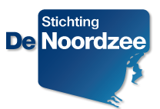
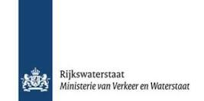
DollyropeFree in context
MSFD
Visserij
Innovation process
Project coördination

Slide 5
A joint investment
‘Founding fathers’:
VisNed
North Sea Foundation
Rijkswaterstaat Zee & Delta
Wing / Wageningen Economic Research (LEI)
With (financial) support by:
Commissioners: VisNed, North Sea Foundation, Ministry of Infrastructure & the Environment
Materialproducers: Ymuiden Stores/Euronete, API-Institute, Herikon, Modified Materials, Peter Koning/PUM
Visserij-innovatiecentrum Zuidwest
Fishermen
Material experts
Research Institutes (ILVO, IMARES, LEI)
Stakeholders involved in litter management in fishing harbours

Slide 6
What is dollyrope and how is it being used?

Slide 7
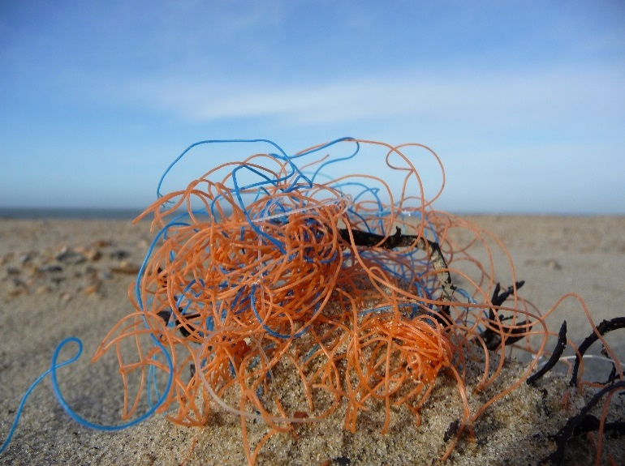
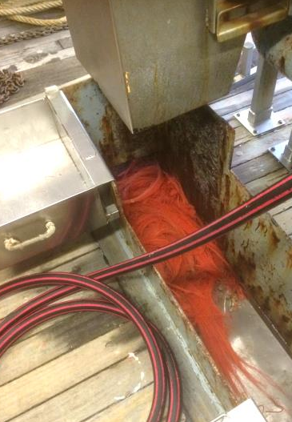
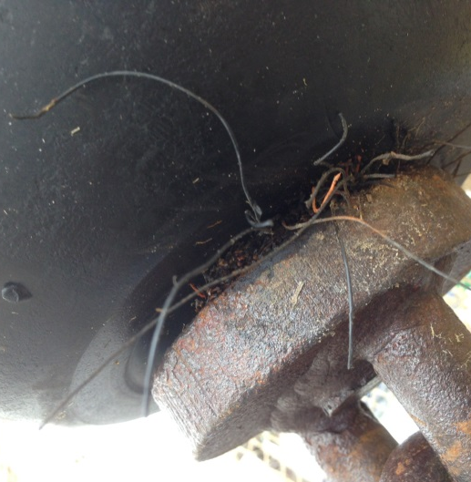
Where does it end up?
On the beach:
+/- 100 pcs/100m beach (top 3 item beach litter monitoring)
On board fishing vessels, in netting and engines

Slide 8
Sources and solutions
Reasons why dollyrope ends up in sea
Abrasion (contact with seabottom)
Behavior of the crew
Dollyropefree: three source-based directions:
Developing alternative materials & net-protection methods
Alternative net design
Awareness & litter management on board and fishing-harbours

Slide 9
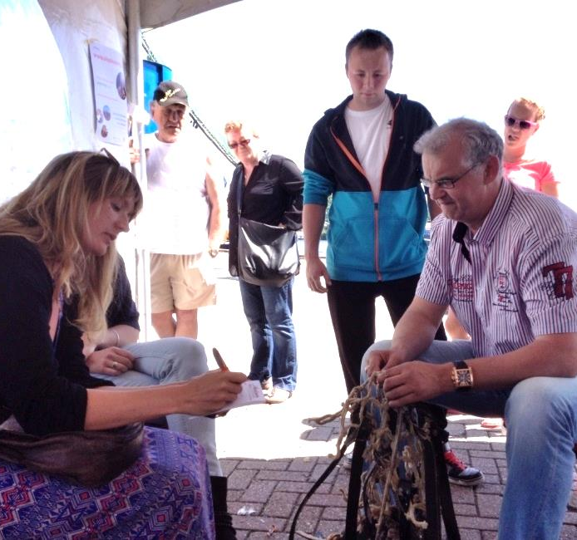
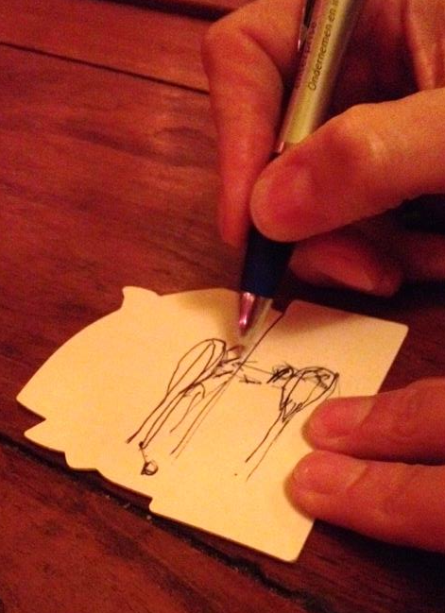
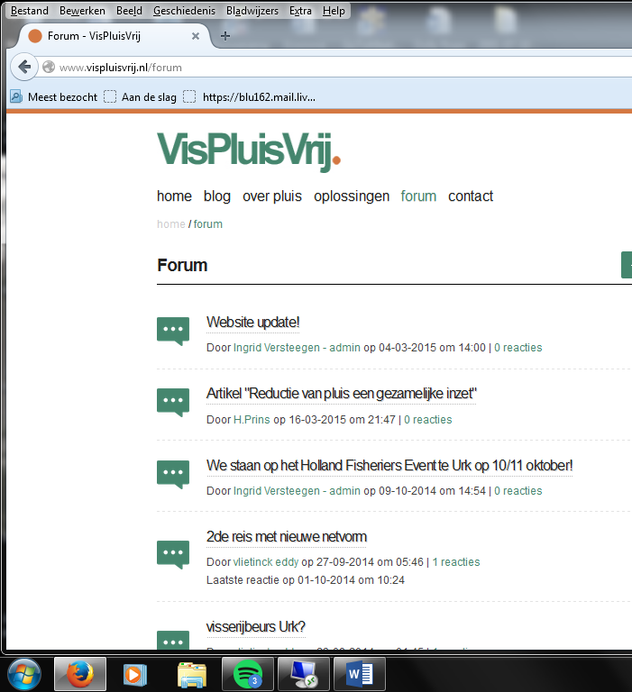
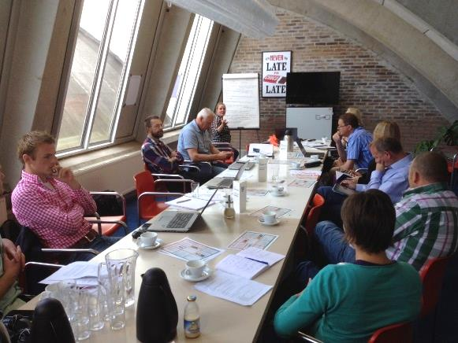
Process coordination Online & Offline

Slide 10
Direction one: alternative materials
Natural sourced materials:
Yak leather (two versions)
Rubber
Wood
Natural fibres: Hemp, flax, Manilla and Sisal
Biopolymers (biodegradable plastics):
TPS/Solanyl**
PLA
PLA-flax composite
PCL met sisal
Two other (‘secret’) materials**
**Biodegradable in water
Other polymers:
Polyurethane
PVC
Polyethylene (conventional dollyrope)

Slide 11
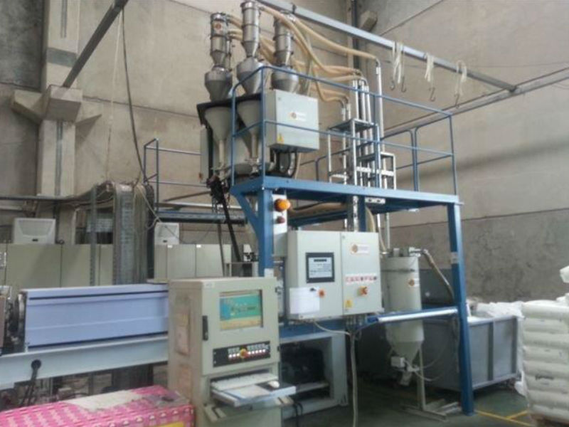
Producing new materials

Slide 12
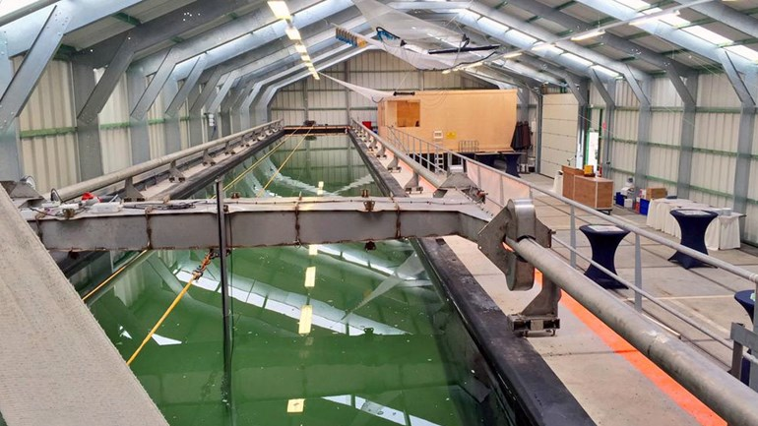
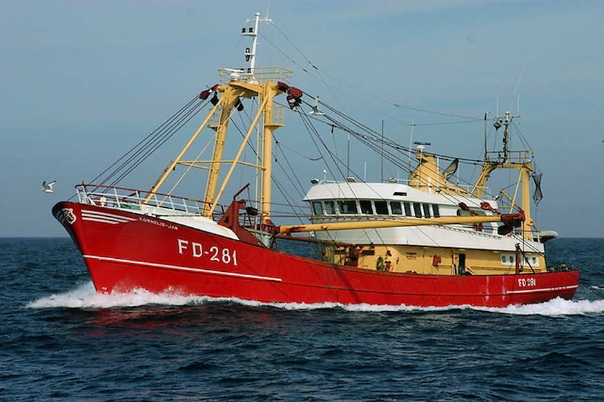
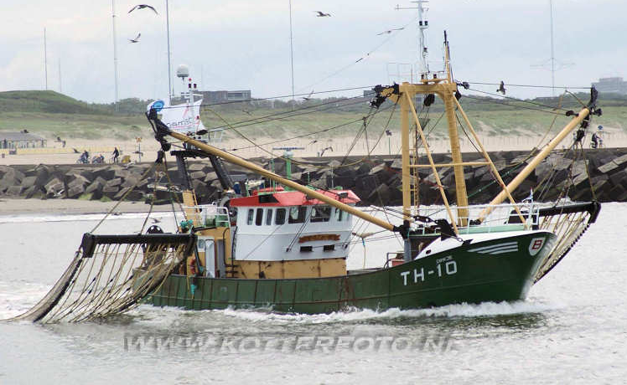
Testing the new materials
Step 1:
Step 2:
Bronnen: www.kotterfoto.nl

Slide 13
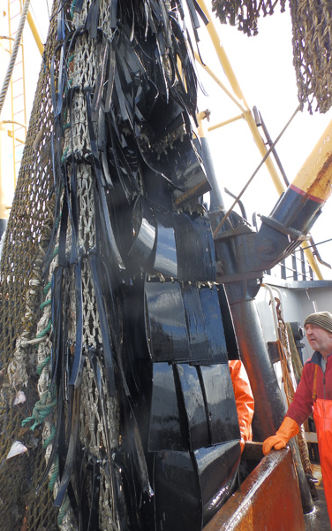
Testing the materials (1)
Alternative materials:
Different design
Different materials
Different combinations of the above

Slide 14
Scoring of the alternatives
Abrasion
Practicality
Degradability in seawater
Recyclability
Availability

Slide 15
The ‘best’ alternative materials so far
Natural sourced materials:
Yak leather (two versions)
Rubber
Wood
Natural fibres: Hemp, flax, Manilla and Sisal
Biopolymers (biodegradable plastics):
TPS/Solanyl**
PLA
PLA-flax composite
PCL met sisal
Two other (‘secret’) materials**
**Biodegradable in water
Other polymers:
Polyurethane
PVC
Polyethylene (conventional dollyrope)

Slide 16
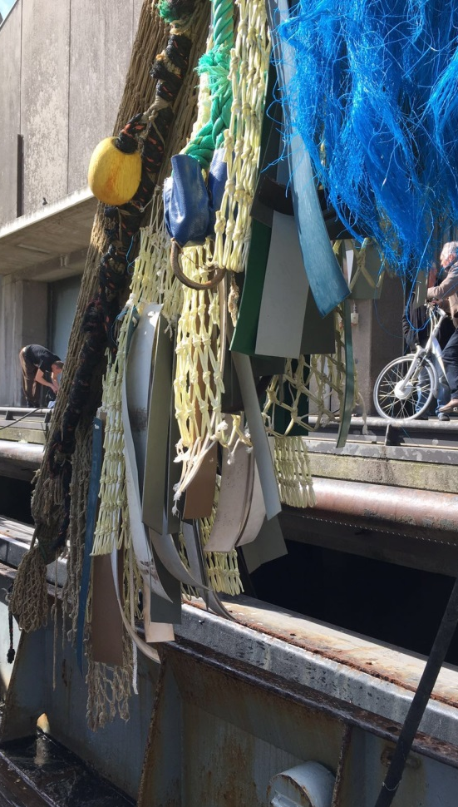
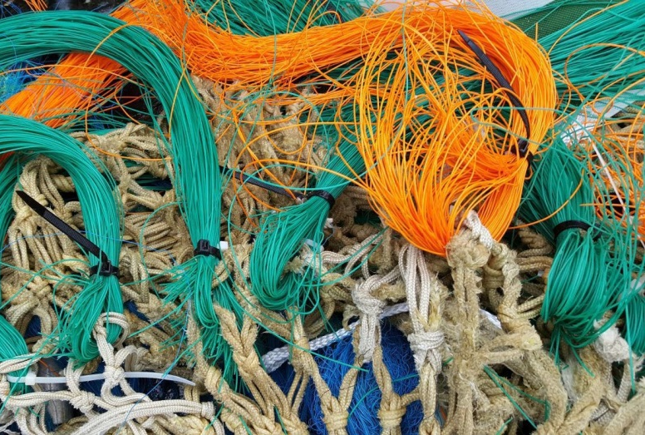
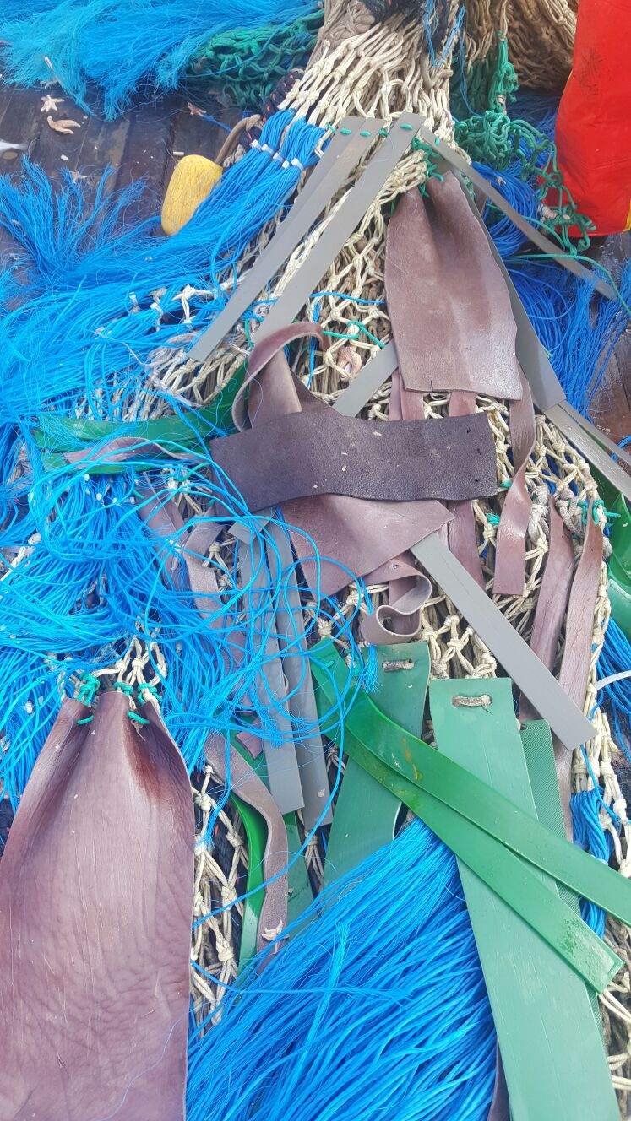
Testing at sea april-august 2016
Materials:
Grey: TPS/Solanyl
Green/blue: Polyurethane
Brown: yakleather
Light blue: pvc
Orange/green threads: ‘secret’ materials

Slide 17
Large scale testing oct-dec 2016
Four materials: polyurethane, natural fibres, yak leather, ‘secret’ materials
First: testing in the seawater tank
Then: large scale testing at sea (35m2 of the net covered with an alternative material)
Option: testing in Germany?

Slide 18
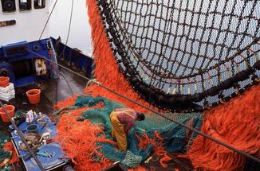
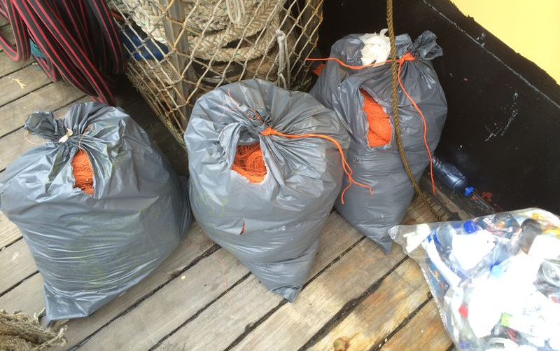
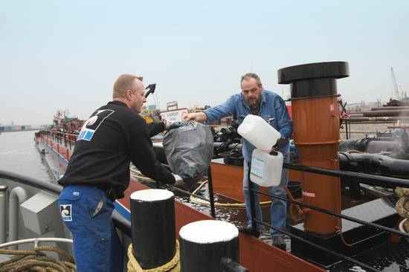
2. Behaviour & litter management
Objective:
To prevent dollyrope threads from entering the marine environment & improvement of litter collection in fisheries harbours
Method:
Facilitating the stakeholder process to make collective agreements on litter management on board and in fishing harbours
Result:
In development (i.e. Green Deal Fisheries)

Slide 19
Regional cooperation
Country: X Y Z
Shared coordination meetings & knowledge exchange trips with participants
Shared activities
Testing each others results
Alternative materials and designs
National variations in focus
Alternative net design
Awareness & litter management

Slide 20
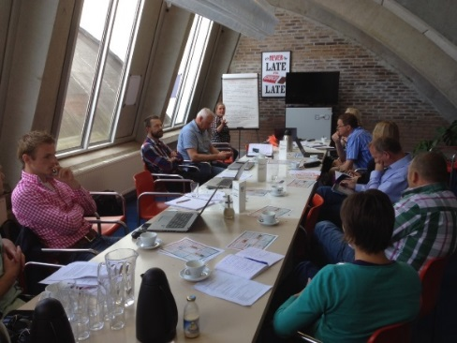
Knowledge exchange

Slide 21
Regional Cooperation
Idea on regional cooperation discussed 11-01-2016, Hamburg:
A shared vision, use of logos and meetings, but variations in focus & funding on the different solution strategies for each country, region or province
Central coordination to make sure experiences and ideas are shared in such a way that all people involved get the most out of their national/provincial projects.
To reduce the administrative burden: each country or province within a country organises its own funding (national or provincial) instead of a common funding for all countries involved.
Knowledge exchange visits and cooperation in material development and testing at sea

Slide 22
Discussion

